Slide 1
Supporting Latinx and Immigrant Students in Culturally Responsive and Asset-based Ways
Dr. Ruth M. López (she/her/ella)
Presentation for Houston Community College
2023 Student Success Summit
Serving Every Student
Notes:
2 minutes - Thank you to Dr. Burridge, Dr. Grays, Dr. Turner, Dr. Miller Waters, Dr. Fortune, Anamaria Lopez, and Alejandra Campos Guerrero for the ongoing discussions we have had about how to address the needs of undocumented students at the college. I hope today continues the discussions we started last summer through a panel with two practitioners from K-12 and higher education. I am proud to have been a partner of HCC during my time as a faculty member, but even before then, as a college outreach counselor in Houston schools, I often engaged with HCC.
In this plenary session, Dr. Ruth M. López will share about her research that has aimed to understand how immigration policies and educational practices impact the lives of Latinx and undocumented immigrant students from K-12 to higher education. She hopes to create a space where participants can learn and share about how they honor the lived experiences of these groups as they work to support their educational and career goals. This session recognizes the rich diversity of the College and underscores our institution’s commitment to equity and sense of belonging for all of our community.

Slide 2
Agenda
My Background & Research
Intersection of Immigration Policy & Education
Excerpts From Two Studies: Latina Pre-College Experiences
Questions
Notes:
1 minute – During our time together, I plan to share about my own educational journey, then an overview of the intersection of immigration policy and education and how this impacts students, then I will briefly share from two of my studies about Latina students. I am going to focus on their pre-college experiences, because I believe that through understanding students journeys TO college, we can better serve them in culturally responsive ways.

Slide 3
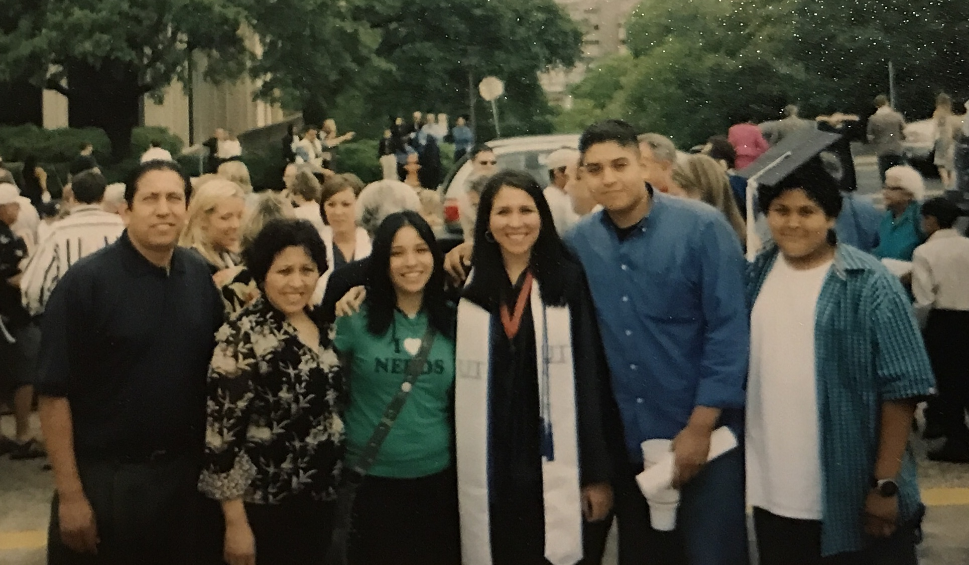
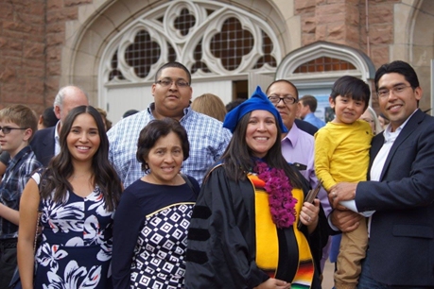
Who I Am
Daughter of formerly unaccompanied immigrant adolescent from El Salvador
Salvadoran Mother came to the U.S. at age of 17 in 1977
Mexican Father came to the U.S. at 17 in 1976
Mexican Grandfather was a guest worker/bracero during WWII
Personal understanding of migrations that occur within a global historical and sociopolitical context
Former “English Learner” educated in Dallas schools
Former youth leader engaged in Latinx organizations
First-generation everything
Mother of school age children
Notes:
5 minutes - Mention how my identities and experience impact the way that I approach my engagement with students and also my work as a professor. In a lot of ways, my experiences now as a mother help me reflect on my own educational experiences and what I want to be better for my children.

Slide 4
P-20 Practitioner & Research Experience [2004-Present]
College Outreach Counselor/Assistant Director
University Outreach Centers Houston (UT-Austin)
Served Houston middle and high schools
Coordinator & Graduate Researcher for STEM Diversity
Colorado Diversity Initiative (CU-Boulder)
High School STEM Study (NSF)
Senior Research Associate
Annenberg Institute for School Reform (Brown University)
Mixed-methods & collaborative evaluations with districts and state education in Massachusetts, Rhode Island, and California
Assistant Professor
K-12 Educational Leadership & Policy Studies (University of Houston)
P-20 Research & Engagement
Notes:
2 minutes - Share how these experiences inform how I think about higher education and access.

Slide 5
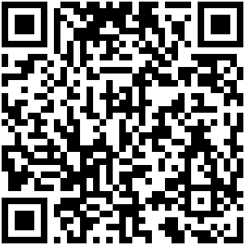
Some of My Research
The intersection of immigration policies and education
Critical Discourse Analysis of TV news coverage of the DREAM Act of 2010
Critical analysis of policies impacting education of unaccompanied children
College access for nondominant students and diversity in higher education
Latinas in higher education (P-20)
Latinx community college students
Notes:
2 min Mention how these overlap—critical approaches, asset-based views of nondominant communities

Slide 6
Intersection of Immigration Policy & Education

Slide 7
[Humanizing] Words Matter
Unauthorized
Undocumented
Immigrant/Migrant Children/Youth/Adolescents
Mixed-Status
When in doubt, ask
Notes:
1 minute - Mention how the media may sometimes use dehumanizing terms

Slide 8
Immigrant & Children of Immigrants in US
Between 11-11.5 million unauthorized immigrants in the United States
Top five states: California, Texas, New York, Illinois, & Florida
2.1 million under 18 years of age
4.6 million 16-34 years of age
3.5 million U.S. citizen children under age 18 with at least one undocumented immigrant parent
Source: Migration Policy Institute and Pew Hispanic Research Center
Notes:
3 min - What does this tell us? Think about the average age of HCC students, think about the parents of HCC students. There are an estimated 11-11.5 million undocumented immigrants living in the United States, and the states with the highest numbers are California, Texas, New York, Illinois and Florida. It is estimated that 2.1 million unauthorized immigrants are under the age of 18 and that there are 4.1 million U.S. citizen children under the age of 18 with at least one unauthorized immigrant parent.

Slide 9
Texas Context
Unauthorized population estimate: 1,739,000
Harris County: 481,000
Top regions of birth: Mexico, El Salvador, Honduras, Guatemala (88%)
Parents of U.S. citizens: 587,000
Harris County: 157,000
Undocumented Texas children and youth
Under 16: 107,000
Ages 16-24: 257,000
Source: Migration Policy Institute tabulation of data from the U.S. Census Bureau's pooled 2015-2019 American Community Surveys.
Notes:
2 minutes-
Source:
Migration Policy Institute tabulation of data from the U.S. Census Bureau's pooled 2009-2013 American Community Surveys.

Slide 10
Undocumented Student Policies Timeline
1982 Plyler v. Doe
Undocumented students gained the right to a K-12 education
Includes unaccompanied immigrant children
2001 DREAM Act first proposed in the US senate
Lived here 5 years; attend college or join military; no criminal background.
2001-Present “State DREAM Acts.”
2001: Texas in-state tuition bill
HB 1503/SB 1528, access to in-state tuition rates
2012 Deferred Action for Child Arrivals (DACA)
Later challenged by Trump administration
Present: Undocumented HS students graduating with no access to DACA
Notes:
5 minutes - The timeline up here represents some of the major events impacting undocumented students in this country. Some estimate that almost 1,000,000 would qualify for the DREAM Act. At the same time, 18 states have passed in-state tuition bills that benefit undocumented students. Some states have also barred undocumented students from either enrolling in state institutions or paying in-state tuition. I examined the DREAM Act versions presented to Congress during President Barack Obama’s first term in office—a time when the DREAM Act was expected to pass, but it did not. In 2012, following pressure from DREAM Act activists and supporters, president Obama issued an executive order called Deferred Action for Child Arrivals (DACA), where many of the undocumented students that would qualify for the DREAM Act were able to get temporary work permits, and in some states get a driver’s license and attend college by paying in-state tuition. Estimates are that 800,000 have benefitted from this program. DACA was expanded in 2014 to include more eligible young people and a new program, Deferred Action for Parents of Americans was also passed by President Obama—both of these programs are on hold due to a lawsuit, but recently the Supreme Court announced that they will take up this case. The last 34 years have been critical in terms of policies for this segment of the population, but it is important to point out that for undocumented students in this country, the PreK-20 pipeline is very uncertain, with a small percentage of undocumented students enrolling in and completing college.

Slide 11
Challenges: K-12 & Higher Education
Confusing policies, lack of policy information, backlash against inclusive policies
Anti-immigrant climate and deficit views of students
Students/families fearful of sharing, educators fearful of speaking openly
Some institutions impede enrollment for undocumented students
Require documents not necessary for enrollment, such as SS
Segregation and tracking of youth
Do undocumented students have access to pre-college and dual-enrollment classes?
Deficit-based educational approaches and perspectives
Are students' languages and cultures valued?
Assumptions about who undocumented students are/are not
Race, ethnicity, language, etc.
What other challenges exist?
Notes:
3 minutes - Mention that even policies that are not about immigrants, such as anti-DEI can have an impact on undocumented students.

Slide 12
Some Recommendations
Acknowledge privileges – For me, although I’m Latina and daughter of immigrants, I was born in the U.S. and have many privileges due to this
Partner with immigrant rights organizations – I always lead with “I am not an immigration attorney, but I know a lot of them.”
Understand that every immigrant student may have a unique story - Age at time of arrival, legal status, family make-up, previous schooling, language, etc.
K-12 partnerships are key – it takes time to establish trust with families, & this will be needed to complete enrollment and Texas financial aid form (TASFA) and enrollment
Notes:
3 minutes

Slide 13
More Recommendations
Complete college/campus-wide assessments of inclusion of undocumented students – surveys, messaging, websites, fliers
Understand transfer and employment requirements – including information about graduate school
Establish undocumented student resource centers – can serve as a way to train staff and student leaders. There are lots of models out there even in Texas!
Check out NASPA Undocumented Immigrants and Allies Knowledge Community! @NASPAUndocuKC on Twitter
Notes:
2 minutes

Slide 14
Reflection to Consider
Imagine what a school [college] culture and climate might look like that provides a safe and supportive environment for all students including undocumented, unaccompanied Indigenous youth, and mixed-status [and even staff]. What structures would need to be in place to support that environment? What is your role in supporting that environment? What other factors should be included-considered when cultivating and maintaining this positive school [college] culture?
– From López & Fernandez (2020)
Source: López, J., & Fernández, E. (2020). “You never know when you will see him again”: Understanding the intersectional dimensions of immigration, indigeneity, and language for unaccompanied indigenous minors. Journal of Cases in Educational Leadership, 23(1), 5-20.
Notes:
1 minute - Ask them to take a moment to jot some notes down thinking about the role they have at HCC. Say, what is your role in supporting this environment.

Slide 15
The Uncertain Path Toward College: How Intersectionality Shaped the Experiences of Latinas Enrolled at a Hispanic-Serving Institution
Notes:
Want to quickly share some of the stories of the young women I’ve interviewed over the years.

Slide 16
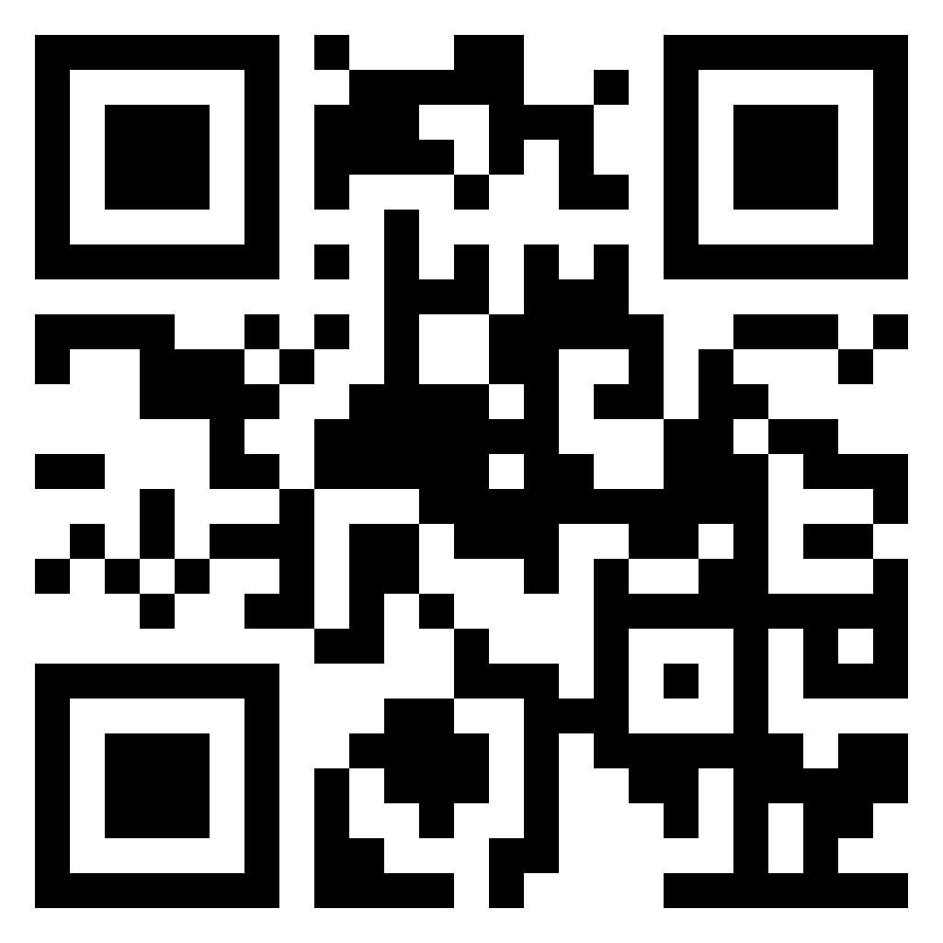
Study Background
Research Question: How did intersectional experiences shape the educational trajectory of Latina undergraduates enrolled at an HSI?
Longitudinal qualitative study of Latina college students at a 4-year Hispanic-Serving Institution
Educational experiences Latinas had during high school as they considered their college path, when enrolling in an HSI, and during college.
López, R. M., Honey, M. L., Rendon, S., & Pérez-Gill, S. (2022). The Uncertain Path Toward College: How Intersectionality Shaped the Experiences of Latinas Enrolled at a Hispanic-Serving Institution. AERA Open, 8.

Slide 17
Literature Review
Latina enrollment at Hispanic-Serving Institutions
Proximity to home (Carales & López, 2020; Contreras & Contreras, 2015)
Supportive role of family and community (Kiyama & Rios-Aguilar, 2017; Matos, 2015)
Face stereotypes based on multiple marginalized identities, but resist oppressive contexts with community (Pérez Huber, 2009; Yosso, 2005).
Critical perspectives on the role of HSIs
Examine servingness beyond enrollment (Contreras et al., 2008; Cuellar, 2019; Garcia et al., 2019; S. Hurtado & Ruiz Alvarado, 2012; Santiago, 2012)
Disrupting traditional measures of excellence and academic success—such as persistence rates and full-time enrollment—to better serve Latinx students (Cuellar et al., 2017; Doran, 2015; Garcia & Okhidoi, 2015).
Notes:
Multilevel mode of intersectionality: Three levels:
(a) multiple social identities (e.g., race, gender, class, national origin, and immigration status),
(b) domains of power (organizational, representational, intersubjective, and experiential), and
(c) historicity (role of history in shaping experiences) (Núñez, 2014, pp. 49–53).

Slide 18
Data Collection & Participants
Face-to-Face & Virtual Interviews from Fall 2017 to Fall 2021
98 interviews for 25 participants across 3 cohorts
25 Student Participants
7 Central American (Salvadoran, Nicaraguan, and Guatemalan)
18 Mexican/Mexican-American
20 daughters of immigrants
8 held DACA status
23 first-generation college students

Slide 19
Immigration and Precollege Experiences
Isabella, a pre-med student in Summer 2019 shared:
Sophomore year…I found out I’m a DACA student. So, that’s when I started finding out, “Oh, you know, what kind of college can I go to? How am I going to pay for college? Scholarships?” And that’s when I kind of started feeling . . . like I wasn’t sure if I going to college or not. I felt very scared. I didn’t know what to do, and even though it was a mostly all-Hispanic high school, there wasn’t enough resources or enough information that they could give me. I did my own research for finding scholarships. And I think being a first-generation Latina and coming to college has been tough because my parents don’t understand sometimes.
Notes:
Undocumented status tied together with attending a low resource school. Through her high school and college experiences, her moth had a deportation case.

Slide 20
Intersectionality & Precollege Experiences
JuJu, a community college transfer student and daughter of immigrants from El Salvador:
I won the [English honors] award too. You know, I was really happy. At the same time, I was kind of sad because I . . . special ed students, they don’t treat them like, you know, like you could be up there. I felt like I was never going to be an honors student. I felt like I was not going to go to college, because in my mind, I mean, I have people say, “Well, you’re in special ed. You know, you can’t do this, you can’t do that.” (Summer 2019)
I was not thinking about college. And that [role model] is my dad because he went to school, but that’s another story. So, he helped me with my math homework when I was little. But, you know, once math advances more, it’s totally different [from] how it is in other countries. And it’s not in Spanish. Everything’s going to be in English. There’s no way he can teach me. And he helped me. I remember he would have his orange fruits or pencils. You know, how you help your kid try to solve a math problem. He’d sit down and help me with that.
Notes:
Mention how JuJu went to community college first and always reflected fondly on her time there.

Slide 21
Counter-stories
In the fall of 2019, Giselle, who was a first-generation college student who attended a high school with majority students of color, shared the following about her high school experience:
[I]t wasn’t the best high school, but there was a lot of potential in that building. I can probably say I’m an example of that, and my friends are an example of that. Our valedictorian got accepted to [private universities], and so there [were] a lot of people with so much potential to be great people. It was just one of those things that we all had to believe in ourselves, because the community outside didn’t believe in us. It made me just that much prouder of everything that I did, because I appreciated it just that much more, because I came from a school that didn’t have a lot of funding. We didn’t have state-of-the-art computers, nothing like that. We were all still succeeding regardless of all of that.
Notes:
What could it look like for youth to not think that they are succeeding regardless, but due to…

Slide 22
Discussion
Identified how multiple forms of oppression and social identities shaped the high school experiences of Latinas and learned how they found belonging at an HSI by finding spaces and individuals who validated their intersectionality.
Demonstrate why Latina student intersectionality prior to enrolling in college is important for researchers and educational leaders to consider.

Slide 23
Examining the Educational Experiences of Latina Early College High School (ECHS) Students

Slide 24
Methods
Longitudinal Qualitative Study
Structured interview protocol via Zoom
Fall 2020 Interview N=12 [7 Latinas]
Fall 2021 Interview N=11 [7 Latinas]

Slide 25
Participant Demographics – Latinas
All 7 Latinas were daughters of Mexican immigrants
All 7 shared that Spanish was their first language and were labeled “English learners” in school
All first-generation college students
6 of 7 were enrolled full-time in college at time of second interview
5 in four-year university
1 in community college
1 working full-time
1 student had DACA status

Slide 26
Findings
Family support they received in elementary and middle school influenced their decision to enroll at an academically rigorous ECHS;
Choosing to attend an ECHS not an individual decision, but rather one informed by their family and community; and
Institutional agents at Eagle ECHS who served as sources of strength that helped students succeed through this rigorous program and become college ready.

Slide 27
Community Cultural Wealth & Critical Resilience in Elementary School
Laura conveyed how she and her mother navigated the educational system while learning English:
There was a bilingual class, but it was too full. So, they gave me another teacher, and she didn’t know Spanish that well. So, I kind of struggled there, and I kind of gave up on trying to find a figure to look up to teach me the English. So, what my mom would do, she would just go to the thrift store, garage sales, and we would buy books in English, and I would just learn to read it… So, I would say my mom was a big aspect that helped me learn English. Even though she didn’t know the language herself, she knew how vital it was to know it in America. So, she consistently proved that through her efforts to get me to learn it. (Laura, interview, 12/01/2020)
Notes:
In this example, Laura demonstrated critical resiliency by sharing how she was placed in a class without a bilingual teacher who would be able to communicate with her mother—this is akin to the systemic inequities and issues of power that Zambrana and Hurtado (2015) discussed. Critical resilience was evident in how she and her mother responded to this educational challenge. Along with linguistic capital, her Spanish-speaking mother displayed resistant capital (Yosso, 2005) when she took her daughter’s education into her own hands by buying books in English wherever she could to support improving her daughter’s English reading.
Also an example of familial capital and linguistic capital.

Slide 28
Critical Latina Student Agency
Maggie discussed the skills she learned as a language broker (Orellana, 2009) and later applied in her college courses:
Eagle EHCS taught me how to mature early; how to grow faster than I was supposed to. I was taking college classes at the age of 14, which most people don’t do. So, I definitely had to grow up faster than everybody else. It’s not something I was not used to doing. I felt like I always had to grow up a little bit faster because my parents depended on me translating and everything like that. So, it’s not something that I wasn’t used to, but it’s definitely something that did impact my experience at Eagle ECHS. (Maggie, interview, 11/17/2020)
Notes:
What could it look like when institutions acknowledge the experiences that students bring?
Maggie acknowledged her responsibility to translate for her family as a young child (Orellana, 2009), and how this linguistic and navigational capital carried through to her high school experiences at an ECHS. Having to “grow up faster” followed by being able to take on rigorous ECHS coursework are experiences that exemplify Latina Student Agency. Maggie’s agency was evident when she took the capital she gained early on in life, which was necessary due to the lack of English language supports and the contexts her immigrant parents encountered in this country, and then used it to be successful at Eagle ECHS.

Slide 29
The Role Institutional Agents
Alex shared that a formerly undocumented teacher told her about “scholarships for people who are DACA students or who are just undocumented in general, talked to me about, instead of applying for FASFA, to apply for TASFA, stuff like that.”
“I really did think that the financial part would be the one that would stop me, but she just said that there’s a lot of grants out there, and there is. Because of her I realized like I can do it if I just keep applying myself.” (Alex, interview, 11/16/2020)

Slide 30
Conclusion & Implications
By including Latinas’ educational journeys from elementary school to college, we revealed how they leveraged their earlier experiences to succeed in higher education
Important to look at Latinas along their educational life course because elementary and middle school experiences for Latina students can determine whether they have access to college.
Family engagement is key not only in K-12, but also in higher education. Families have been engaged since early education, and it means a lot to stay engaged.
Notes:
Bring back relevance to the framework
Mention how we heard this in Comadres too.

Slide 31
Returning to Our Reflection
Imagine what a school [college] culture and climate might look like that provides a safe and supportive environment for all students including undocumented, unaccompanied Indigenous youth, and mixed-status [and even staff]. What structures would need to be in place to support that environment? What is your role in supporting that environment? What other factors should be included-considered when cultivating and maintaining this positive school [college] culture?
– From López & Fernandez (2020)
Source: López, J., & Fernández, E. (2020). “You never know when you will see him again”: Understanding the intersectional dimensions of immigration, indigeneity, and language for unaccompanied indigenous minors. Journal of Cases in Educational Leadership, 23(1), 5-20.
Notes:
Ask them to take a moment to jot some notes down thinking about the role they have at HCC.

Slide 32
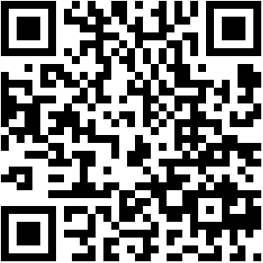
Thank you! Questions?
Contact me at : RMLopez3@uh.edu

Slide 33
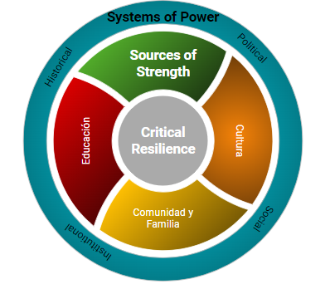
Critical Latina Student Agency (CLSA)
Allowed us to examine the contexts and college-going experiences of Latina students from an asset-based perspective as well their multiple social identities and systems of power they navigate
Identified their agency across various environments
Outer Level: Systems of Power
Middle Level: Sources of Strength
Inner Circle: Critical Resilience
Notes:
Give credit to my collaborators: Vincent Carales, Las Comadres Research Team, Graduate Assistants
Through these studies I really hope to highlight how my research addresses the experiences of Latina college students before they ever set foot on campus. What I have learned from these studies often shows up in my teaching of educational leaders and when engaging higher education leaders about the critical role of collaborations with K-12.

Slide 34
Theoretical Framework
Chicana Feminist Epistemology (Calderón et al., 2012; Delgado-Bernal, 1998; J. Flores & Garcia, 2009; A. Hurtado, 2003)
Challenges the notion of objectivity in educational research, acknowledges the differences of Chicanas’ lived experiences, and presents women’s intuitions as valid sources of knowledge.
Intersectionality (Collins, 2015; Crenshaw, 1991; A. Hurtado, 2018; Zambrana & Hurtado, 2015)
Examine how multiple forms of oppression (e.g., racism, classism, sexism, nativism, and ableism) shaped Latina students’ educational experiences from high school to college.
Multilevel model of intersectionality for college access and success of Latinos in higher education (Núñez, 2014).
Notes:
Multilevel mode of intersectionality: Three levels:
(a) multiple social identities (e.g., race, gender, class, national origin, and immigration status),
(b) domains of power (organizational, representational, intersubjective, and experiential), and
(c) historicity (role of history in shaping experiences) (Núñez, 2014, pp. 49–53).

